Slide 1
Autonomous Robotics: Feed-Forward Neural Network with Vehicle Dynamics
Richard Hoffmann
Department of Computer Science
University of Colorado at Boulder

Slide 2
Roadmap
Project 1:
week 1-2: Semantic segmentation
Project 2:
Week 2-4: Vehicle construction and testing
week 5-6: Neural network design, training, and testing

Slide 3
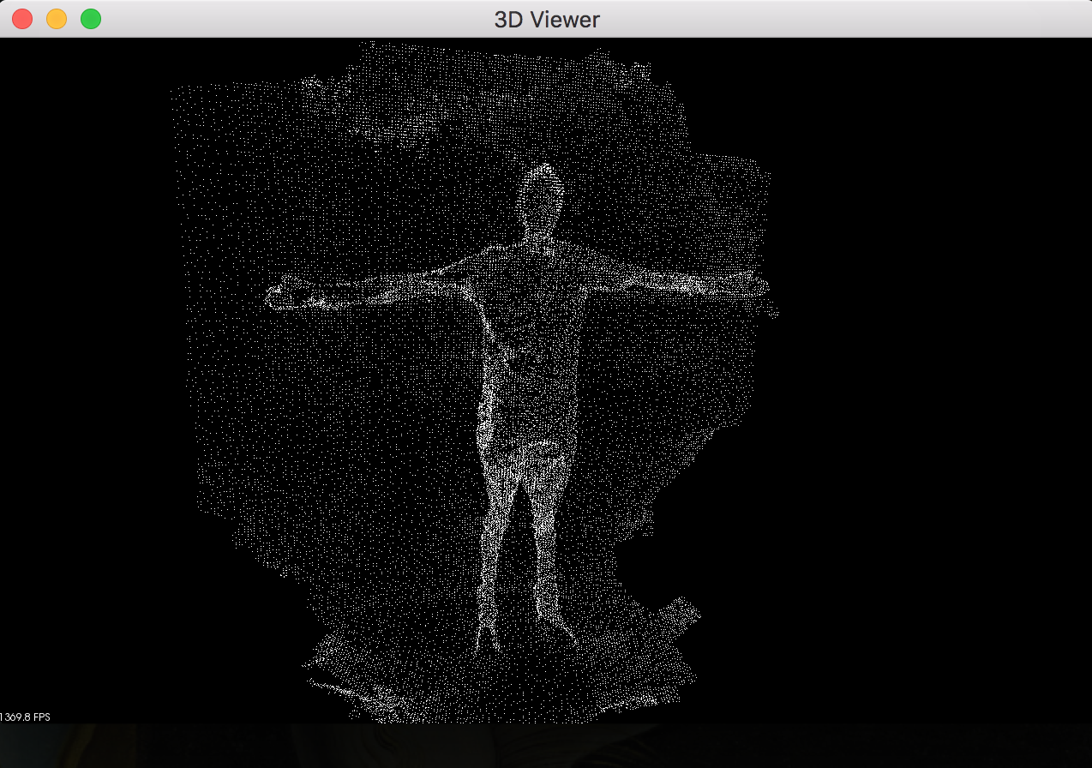
First Task
Labeling data on Point Cloud
Used Semantic Segmentation tool
Labeled by hand shrubs and ConMods

Slide 4

Moab, Utah

Slide 5
Moab, Utah

Slide 6
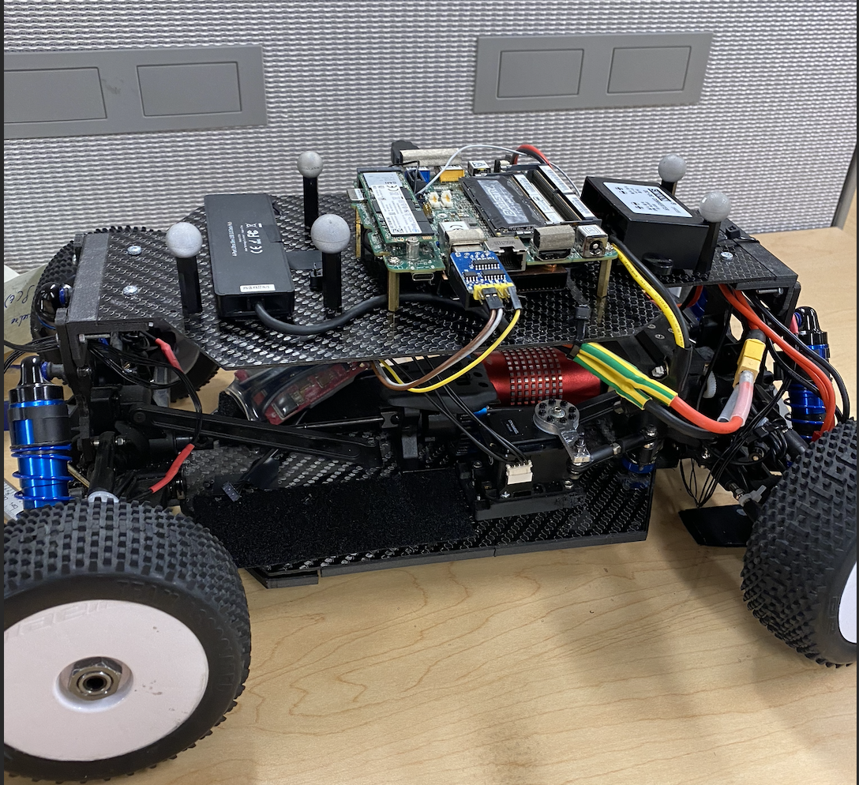
Next Project
Goal: Using real data, generate a NN capable of approximating vehicle dynamics from measured state data.
Fitted and soldered wires on the car, made sure onboard computers were connected to LiPo battery

Slide 7
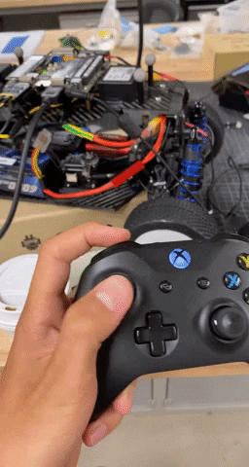

Slide 8
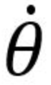
Vehicle Kinematics as NN
Goal #1: Develop feed-forward neural network capable of approximating vehicle dynamics (ẋ, ẏ, ) given vehicle state data (speed, 𝜽, steering, v_{x}, v_{y}).
Goal #2: Test if NN is better than the bicycle kinematic vehicle model.

Slide 9
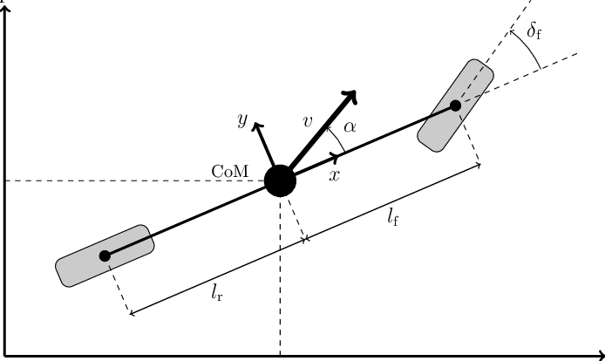
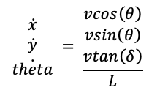
Bicycle Model
Used bicycle model to find kinematic predictions
Calculated error of predictions

Slide 10
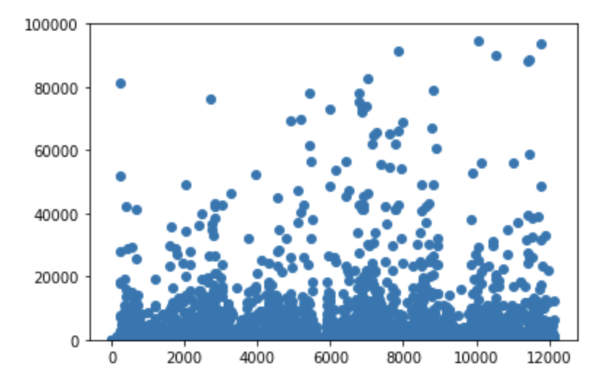
L2 Loss of Bicycle Model
Outliers in dataset drove the L2 loss very high
Yaw had extreme outliers based on quick data check
Decided to first make a NN to output only translation data
Avg L2 error for whole dataset:
L2 Error Bounds | Number of Samples
0 - 50 | 8475
50 - 100 | 457
100 - 500 | 1022
500 - 100000 | 2182
100000 - 10^15 | 12

Slide 11
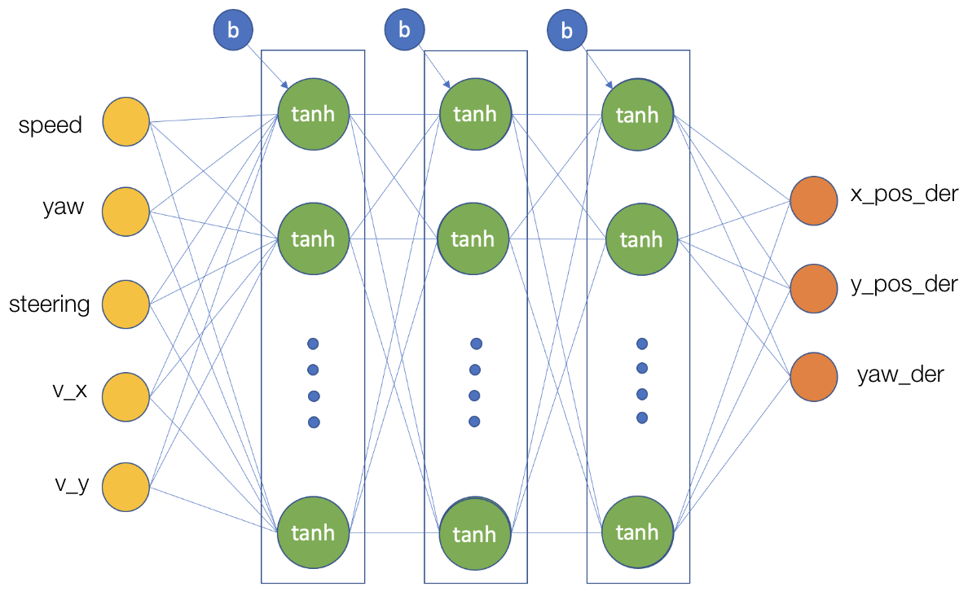
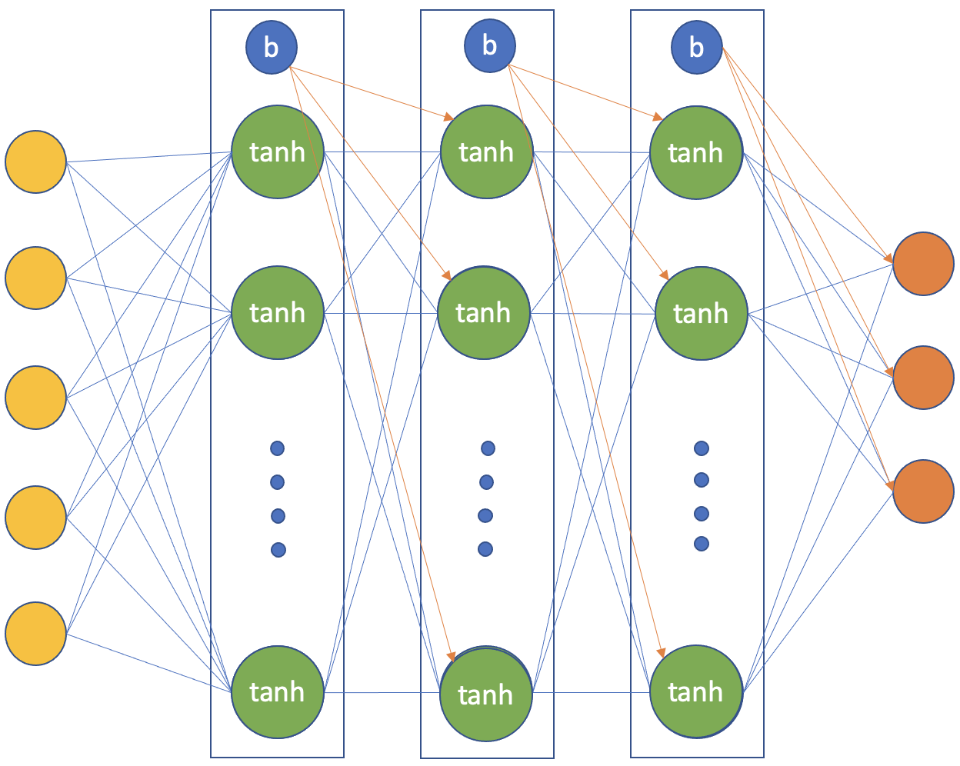
Neural Network
36 nodes
36 nodes
36 nodes

Slide 12
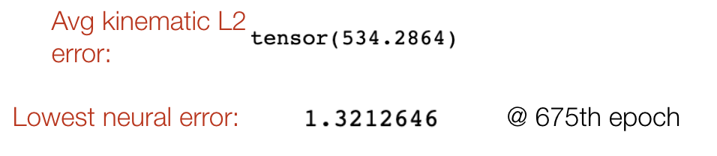
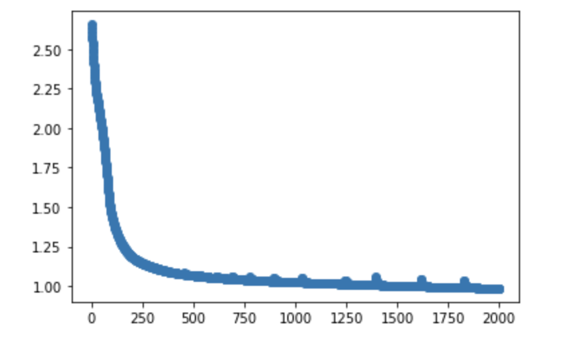
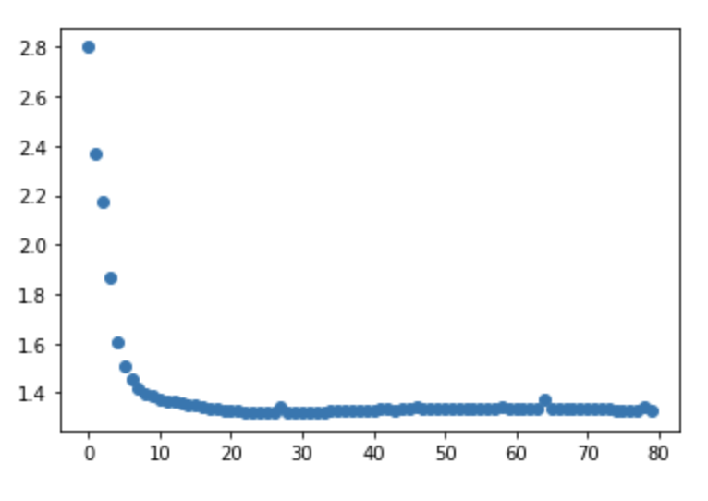
NN Without Yaw
Trained network with a 70/30 train/test split
(Bicycle Model)
Test set only
Training
Test

Slide 13
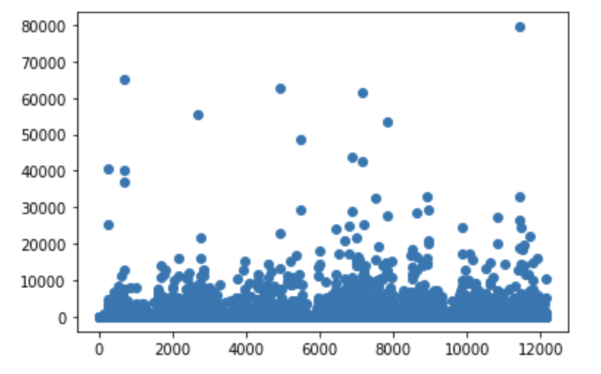
Downsampling via Translation Error
There are still a lot of outliers in the translation data
L2 error over 50 was removed from the data set
From 12148 data samples down to 9146
Kinematic translation error plot:
L2 Error Bounds (x + y) | Number of Samples
0-50 | 9146
50-100 | 366
100-500 | 1039
500-100000 | 1597

Slide 14
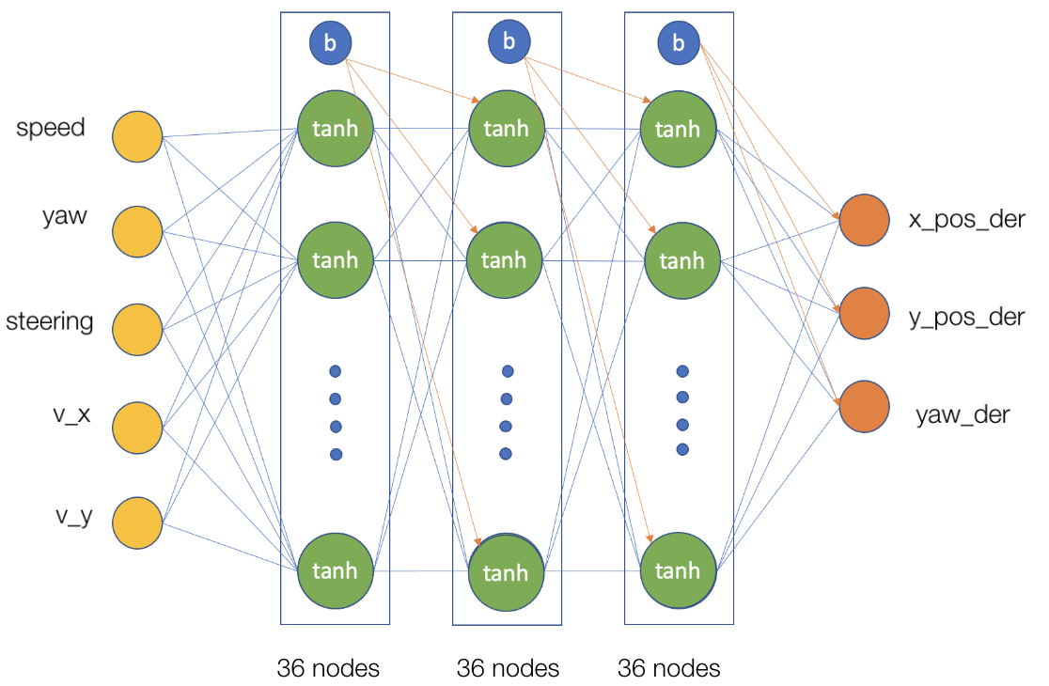
NN on Downsampled Data
Now we want to compare downsampled NN with Kinematic model
still no yaw output

Slide 15
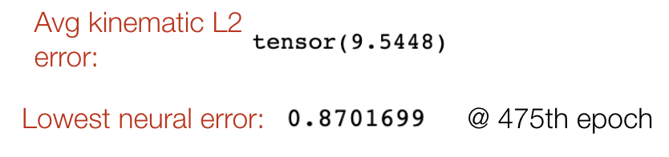
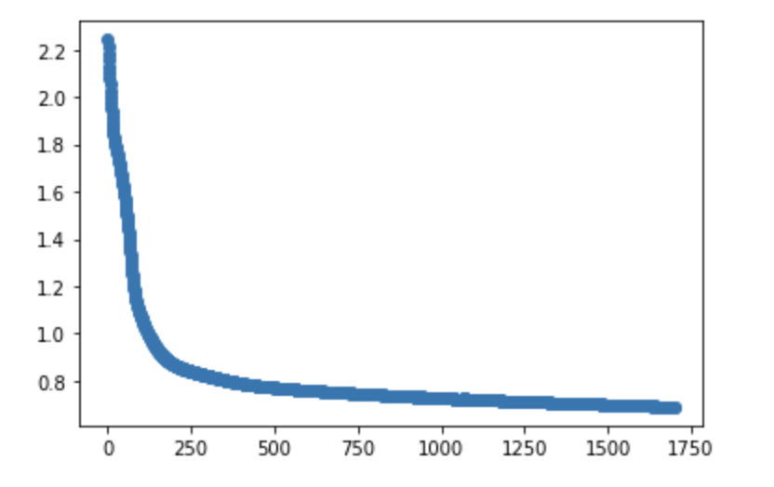
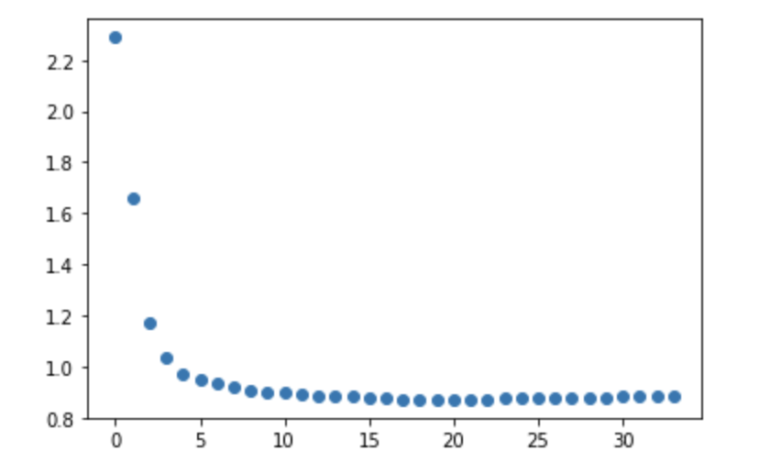
NN Downsampled Performance
 | NN w/o Yaw | Downsampled data
Avg kinematic L2 error | 534.286 | 9.5448
Lowest neural error | 1.3212646 | 0.8701699
Train
Test

Slide 16
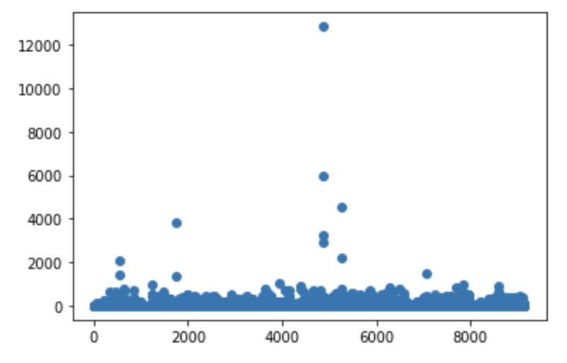
Yaw Downsampling
Removing the translation noisy samples didn’t remove all of the yaw noise
Further reduced from 9146 to 8211 data samples
L2 Error with Yaw:
L2 Error Bounds (yaw) | Number of Samples
0-50 | 8211
50-100 | 400
100-500 | 477
500-100000 | 58

Slide 17
Neural Net with Yaw

Slide 18
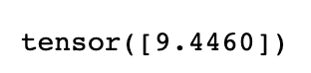
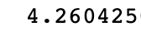
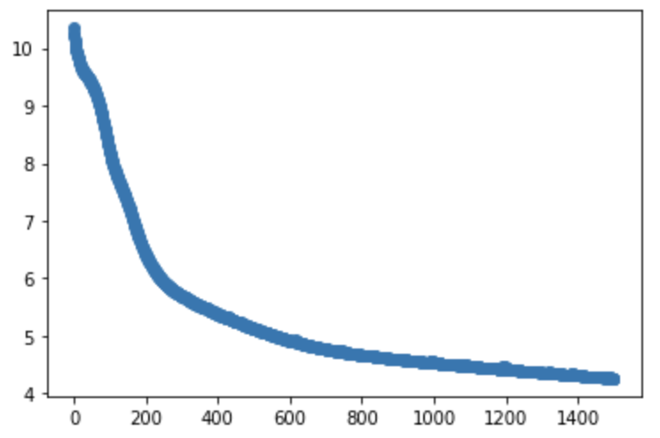
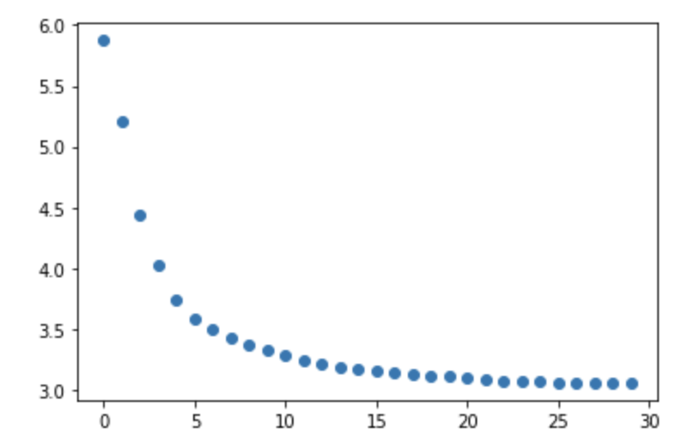
Second Downsampling
 | Total Data Samples | Train Data Samples | Test Data Samples
Original | 12148 | 9000 | 3148
After translation Downsampling | 9146 | 6402 | 2744
After Yaw Downsampling | 8211 | 5747 | 2464
Avg kinematic L2 loss:
Lowest neural loss:
@ 1497 epochs
Train
Test

Slide 19
Conclusions
Lessons Learned
A well-trained NN beats bicycle model, but requires good data
Mocap space is noisy (specifically the velocity measurements).
Improve data with outlier removal
Possible Future Improvements
Dropout could be included in the model to increase its robustness to noise
Layer layout and activation function may not be ideal, we used a similar setup as the Georgia Tech Rally car
Possibly separate translation and yaw NN.

Slide 20
Thank you

Slide 21
backup

Slide 22
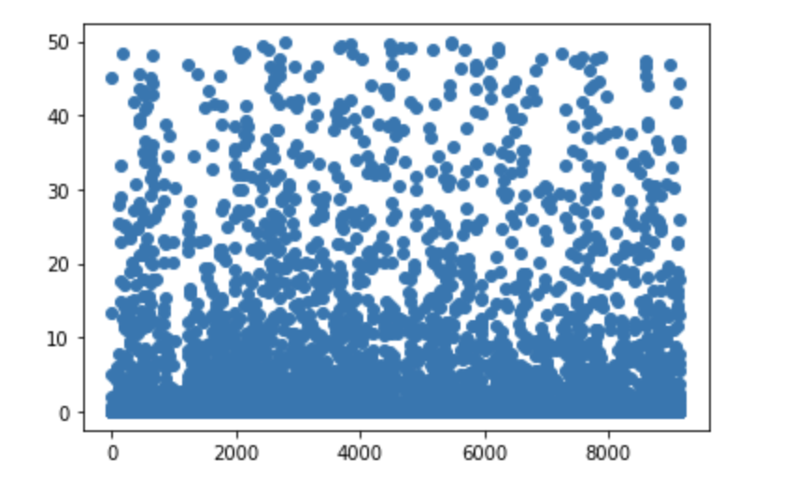
Plotting downsampled X

Slide 23
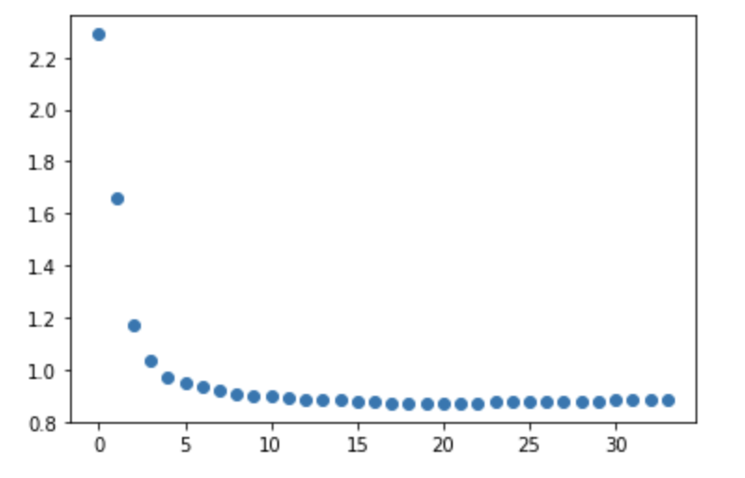
Test Loss
Overfitting starts around here
~ 1500 epochs
This net ran for 1700 epochs

Slide 24
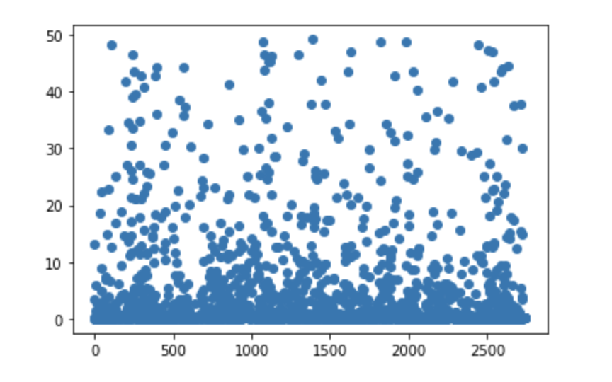
Kinematic error plot

Slide 25
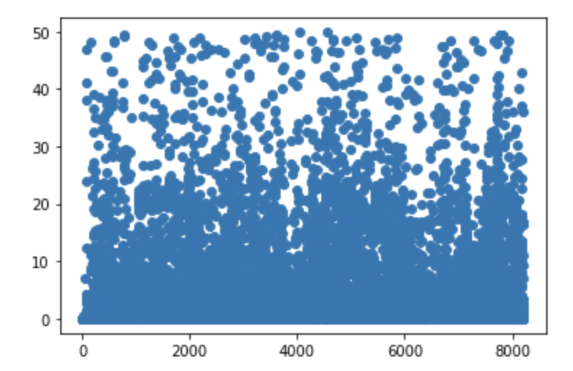
Downsampling yaw error

